Slide 1


S.V.N. Chaita, Samastipur
School Management System
Warish Kumar (205220684014)

Slide 2
S.V.N. Chaita, Samastipur
Faculty of Computer Application (FoCA)
Project Completed Under Guidance of
Internal Guide: Ashwin Dobariya
External Guide: Abhishek Pujara
Project Prepared By: Warish Kumar (205220694014)
Warish Kumar (205220684014)

Slide 3
Introduction
Our School Management System is a large database system which can be used for managing school’s daily work.
It is a multi-user system and can be used by hundreds of users at same time according to the Server strength.
Generally, we can say it is a platform available for running on a Local Area Network (LAN).
This School Management System is a business Optimization of school or Educational Institute and its processes
Warish Kumar (205220684014)

Slide 4
Purpose of System
School Management System become in all school, college or other educational institute to manage their whole system.
It can used to manage all administrative and all students' management problem within Local Area Network.
Admin can handle whole administration system of school; teachers can manage all their required management and students can students can also get access their details within that Local Area Network.
Warish Kumar (205220684014)

Slide 5
Django Concept that used
HTML
CSS
JavaScript
Bootstrap
Django Default Admin Panel
Python Library
MTL Model of Python
Django Jinja Technic
Warish Kumar (205220684014)

Slide 6
S.V.N Chaita, Samastipur
Core Components:
There are 3 core components in our web application.
School Administrators
Teachers
Students
Warish Kumar (205220684014)

Slide 7
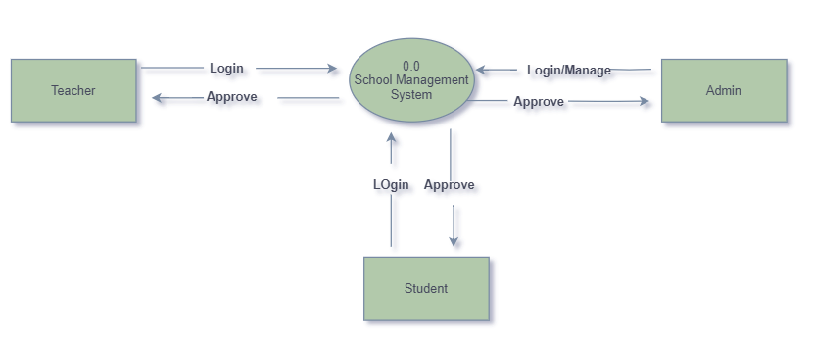
Data Flow Diagram (DFD – 0 level)
Warish Kumar (205220684014)

Slide 8
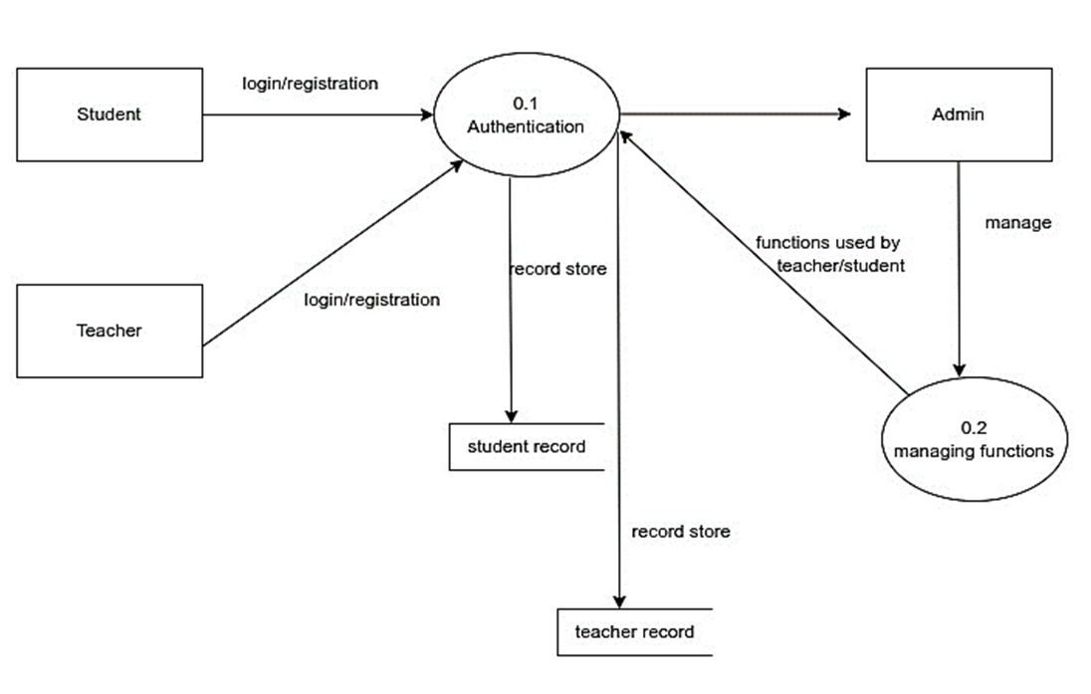
Data Flow Diagram (DFD – 1 level)
Warish Kumar (205220684014)

Slide 9
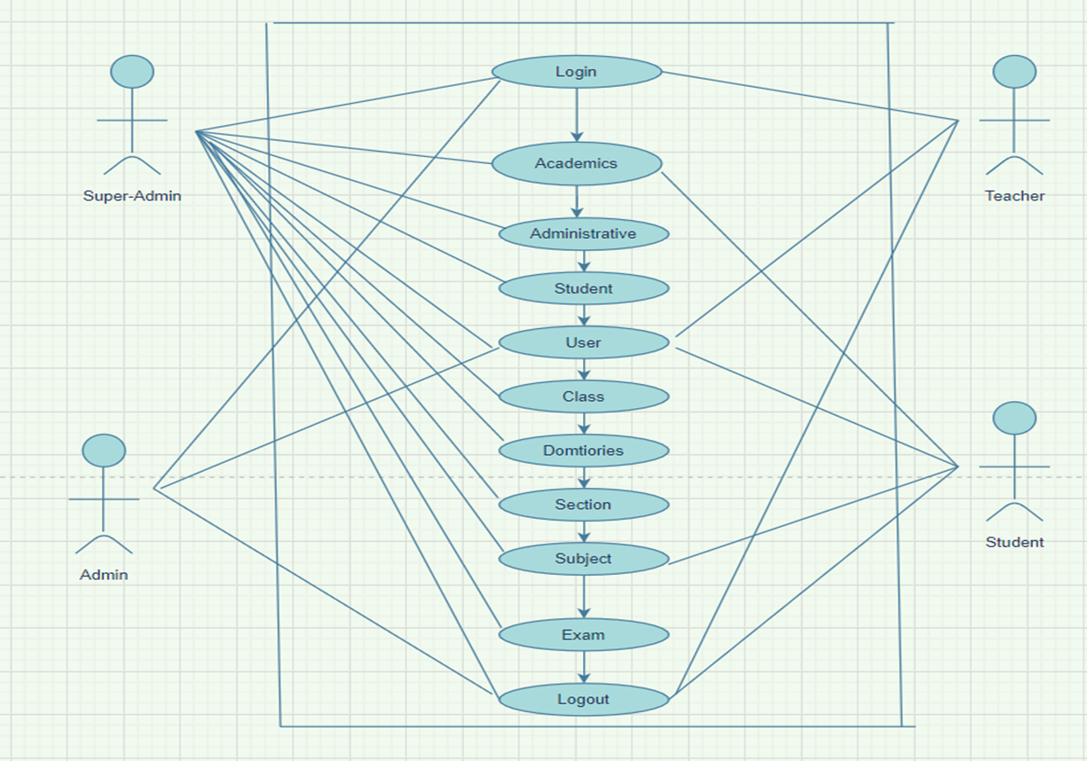
Use Case Diagram

Slide 10
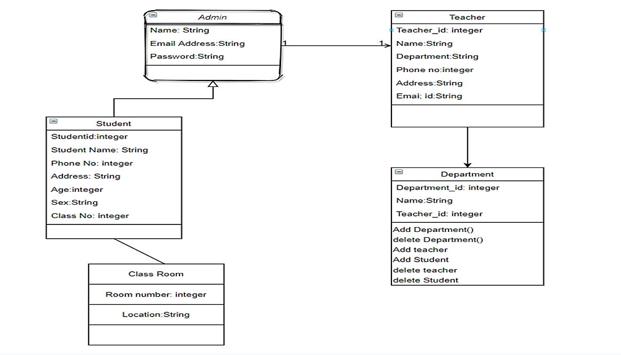
Class Diagram

Slide 11
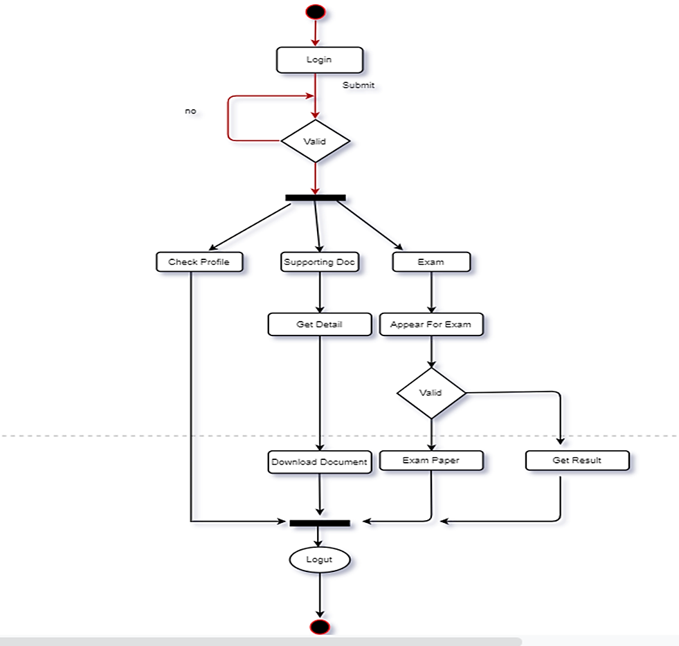
Activity Diagram of Admin

Slide 12
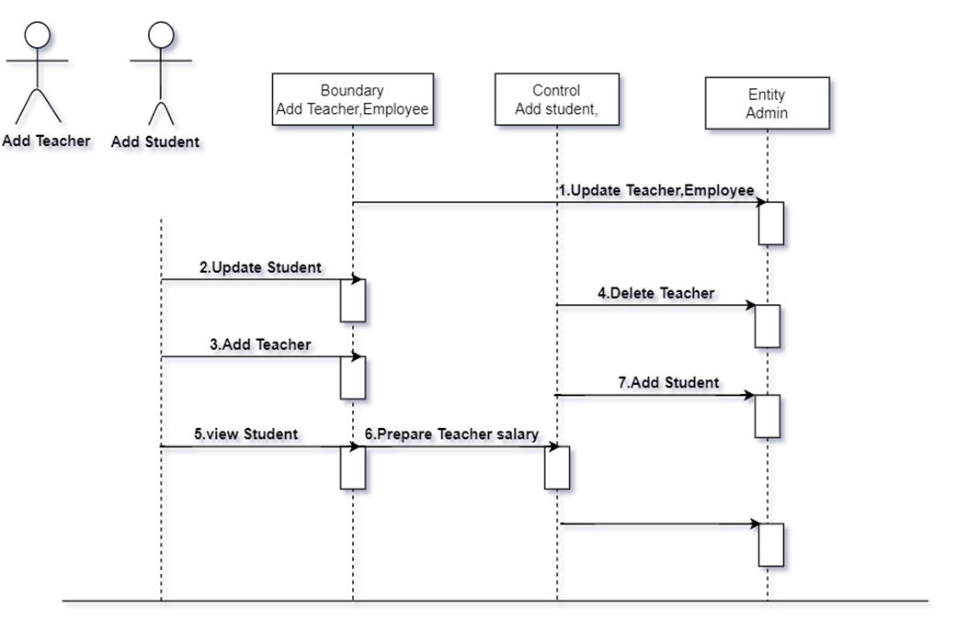
Sequence Diagram

Slide 13
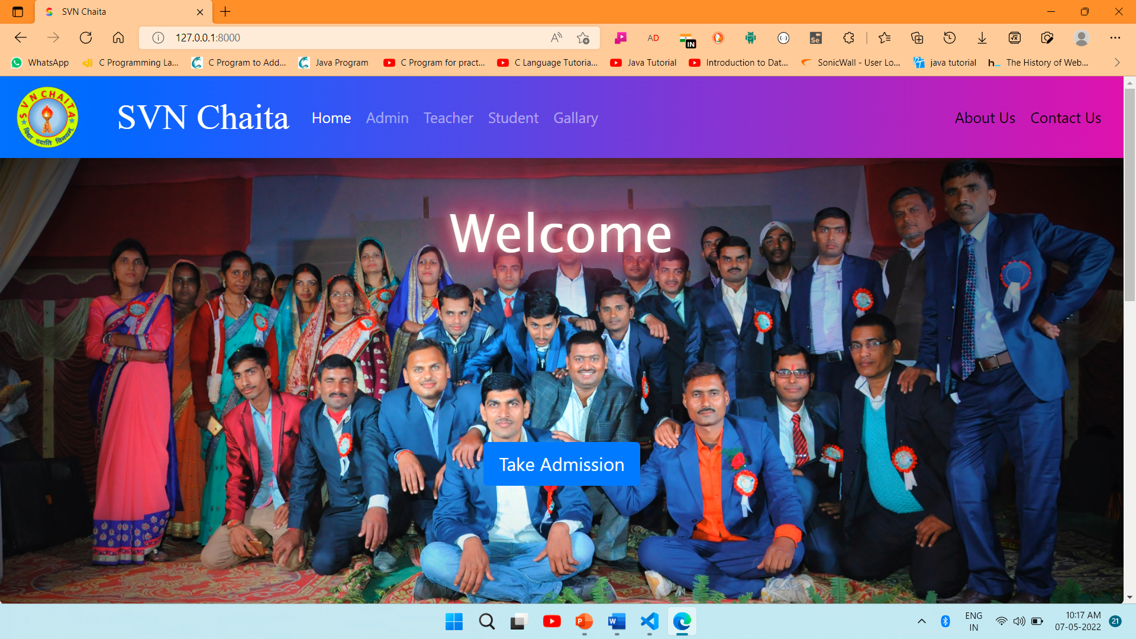
S.V.N. Chaita, Samastipur
Home Page
Home Page is default Page of this “School Management System”. Admin, Teacher and Students can interact from here by going login inside.
Warish Kumar (205220684014)

Slide 14
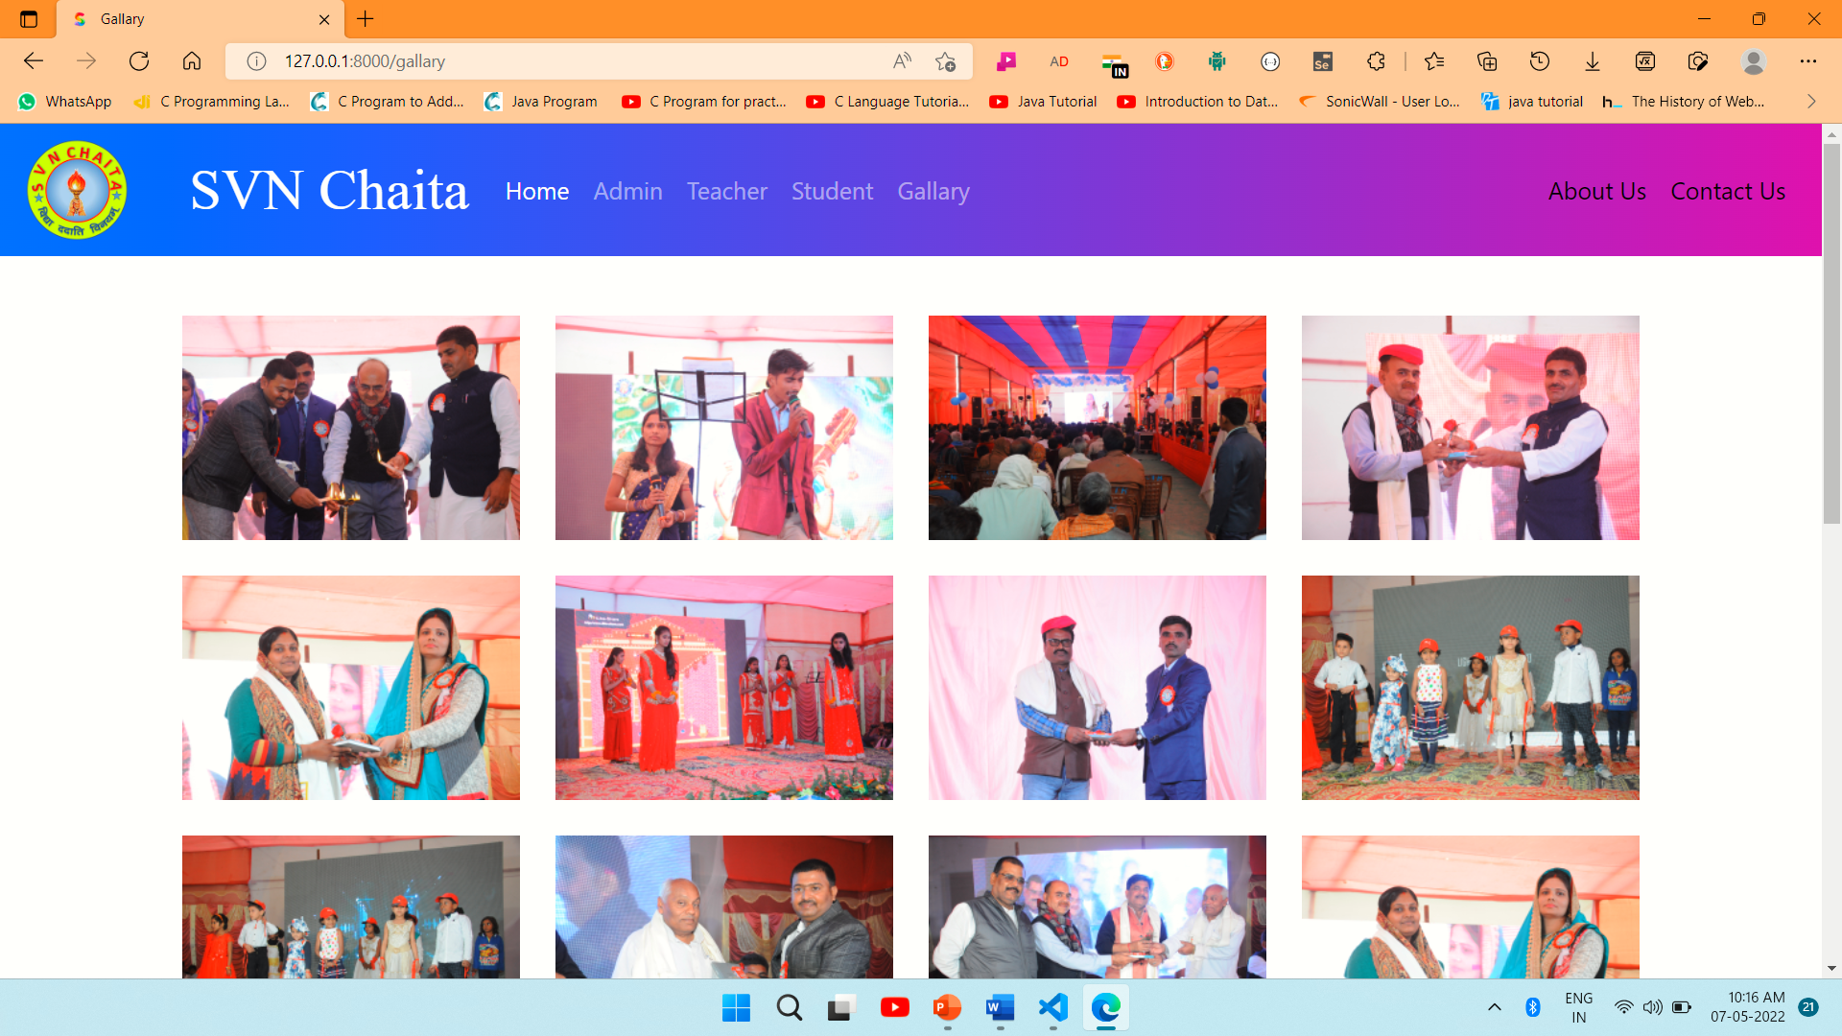
S.V.N. Chaita, Samastipur
Gallery
Keep all memories and achievement of the organization in the form of picture gallery.
Warish Kumar (205220684014)

Slide 15
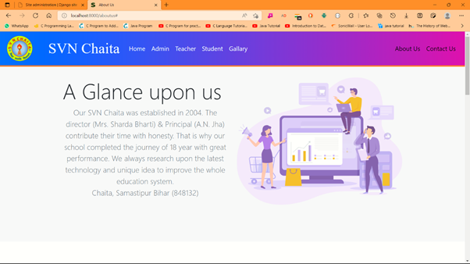
S.V.N. Chaita, Samastipur
About Us
This page contain the all-basic details about the organization. All the services and facilities are listed here.
Warish Kumar (205220684014)

Slide 16
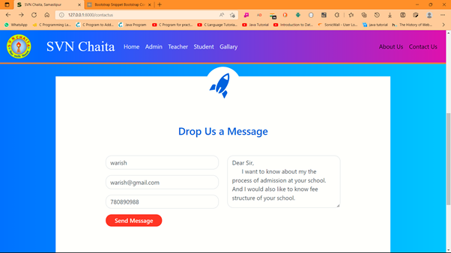
S.V.N. Chaita, Samastipur
Contact Us
Through this page anyone can contact to organization for an enquiry. They can also fee their contact detail for communication and also mention their queries.
Warish Kumar (205220684014)

Slide 17
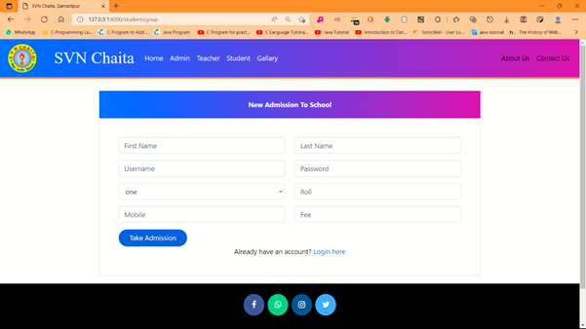
S.V.N. Chaita, Samastipur
New Admission
New Students can SignUp here to take admission by provide their basic information as Name, Username, Password, Class, Mobile and Admission Fee.
Warish Kumar (205220684014)

Slide 18
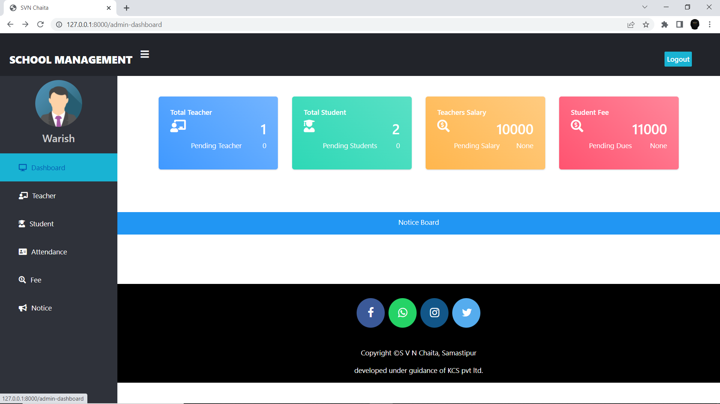
S.V.N. Chaita, Samastipur
Admin Dashboard
Admin have full right to manage all the data of Teachers, Students and the fee of both. Even he can add teacher, student particularly. All pending status can be approved by an Admin
Warish Kumar (205220684014)

Slide 19
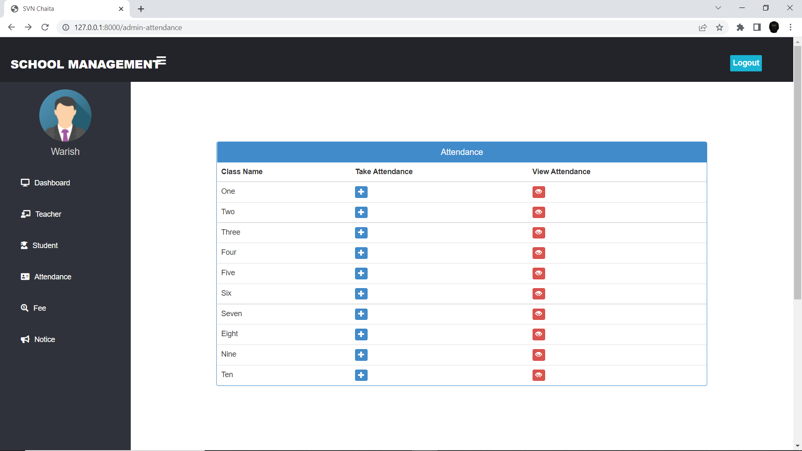
S.V.N. Chaita, Samastipur
Attendance
Admin can see who is present or not present in class. He can mark the attendance of any students and view the attendance as required.
Warish Kumar (205220684014)

Slide 20
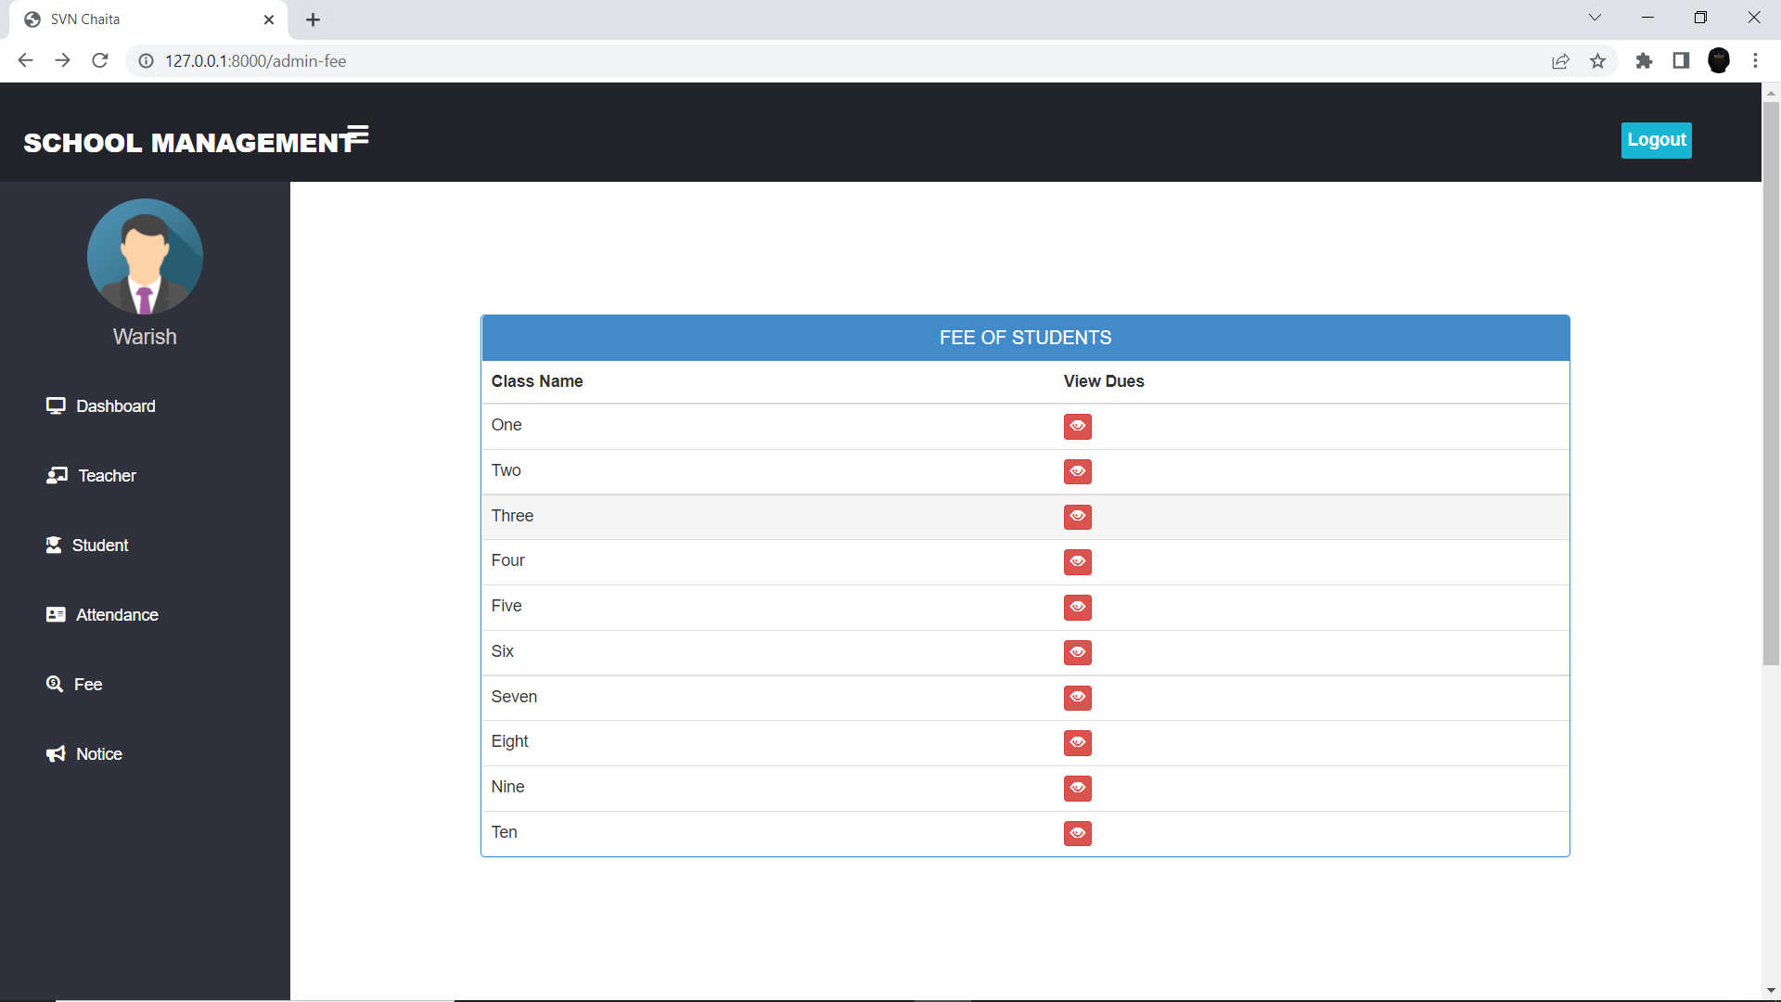
S.V.N. Chaita, Samastipur
Fee Management
Admin can view the all-pending fee of Students from respective classes. And he can manage the fee management accordingly.
Warish Kumar (205220684014)

Slide 21
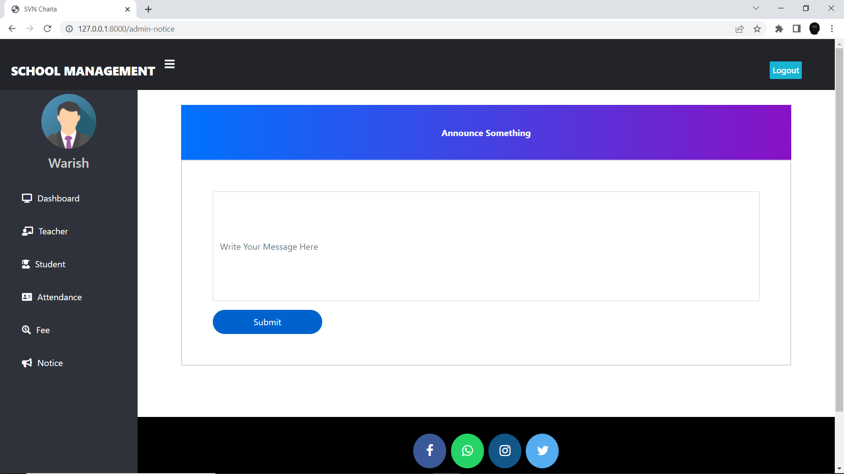
S.V.N. Chaita, Samastipur
Notice/Announcement
Admin can make announce anything regarding the students and teacher according to requirement. This is the best thing to broadcast the notice in whole administration system.
Warish Kumar (205220684014)

Slide 22
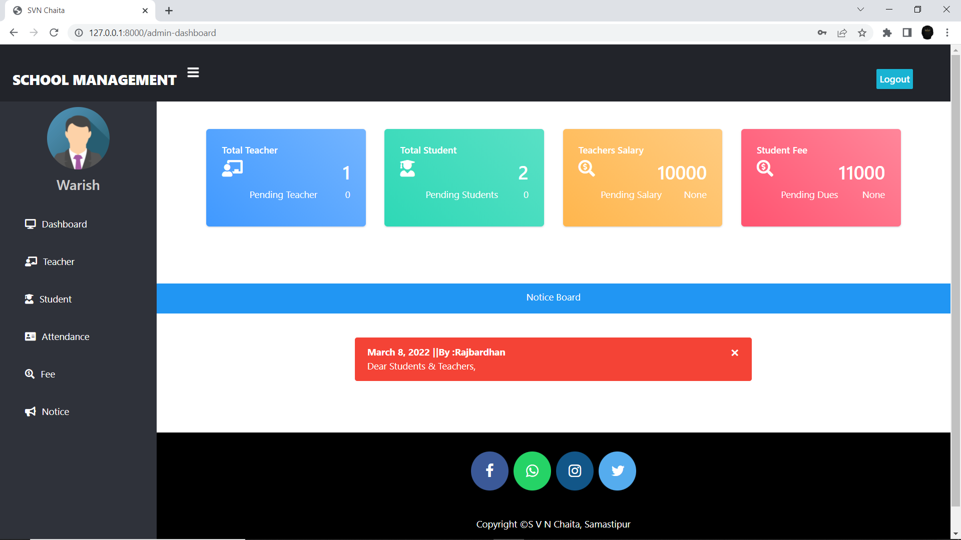
S.V.N. Chaita, Samastipur
Teacher Dashboard
A teacher have access to add students, manage the attendance. And see the pending fee. He can also put any type of notice regarding students and management.
Warish Kumar (205220684014)

Slide 23
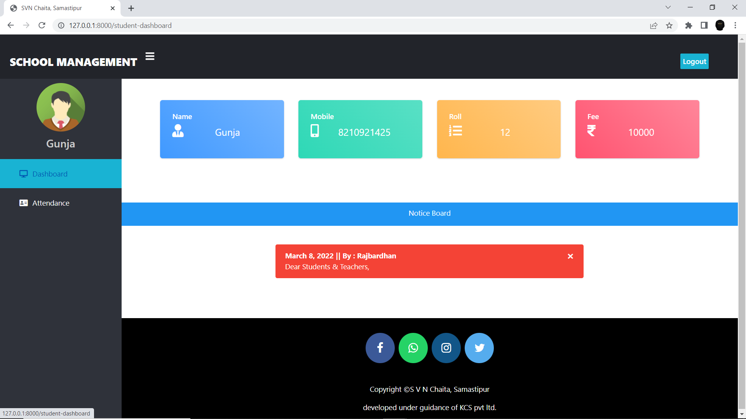
S.V.N. Chaita, Samastipur
Student Dashboard
A student can see their basic details as Name, Mobile Number, Roll No. Fee and Attendance.
He / She have not right to make any type of changes in their profile. He can only see.
Warish Kumar (205220684014)

Slide 24
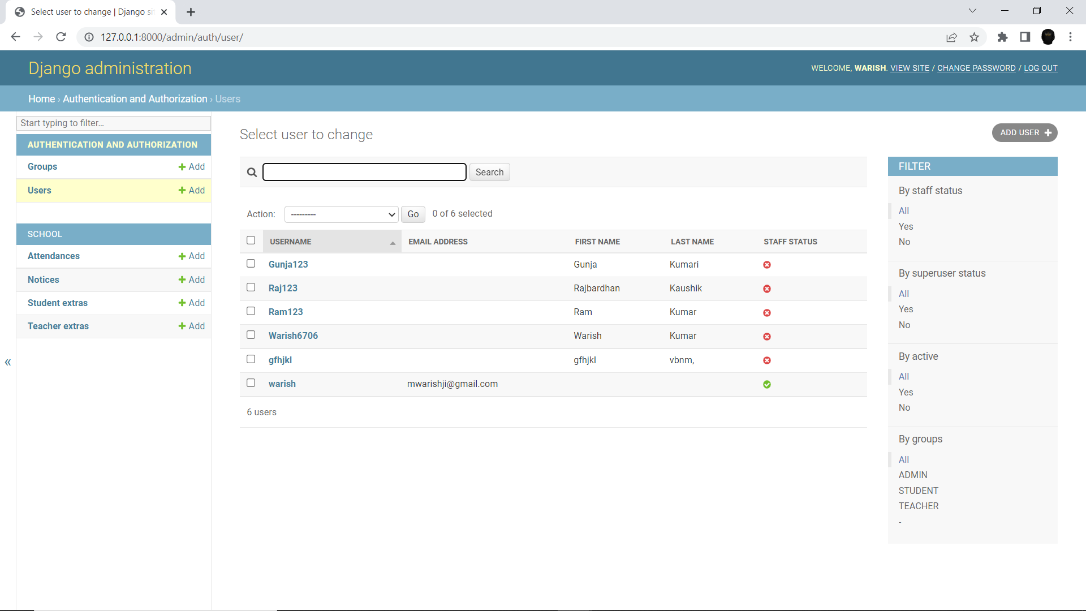
S.V.N. Chaita, Samastipur
Django Administration
This is the main Administration panel provided by Django in default. All the activity of Admin, Teacher and Students. This is very secure in sense of security because it provide default encryption and decryption.
Warish Kumar (205220684014)

Slide 25
auth_group
Sr. No. | Fields | Data Type | Size | Constraint
1 | Id | int | (10) | Primary key
2 | name | varchar | (150)
django_adminlog
Sr. No. | Fields | Data Type | Size | Constraint
1 | Id | int |  | Primary Key
2 | Action_time | Datetime
3 | Object_id | Text
4 | Object_repr | Varchar | 200
5 | Change_message | Text
6 | Content_type_id | Int
7 | User_id | Int
8 | Action_flag | Smallint unsigned
Warish Kumar (205220684014)

Slide 26
auth_user
Sr. No. | Fields | Data Type | Size | Constraint
1 | id | int | 11 | Primary Key
2 | Password | varchar | (150)
3 | Last_login | Datetime
4 | Is_superuser | Bool
5 | username | Varchar | 150 | Foreign Key
6 | Last_name | Varchar | 150
7 | Email | Varchar | 254
8 | Is_staff | Bool
9 | Is_active | Bool
10 | Date_joined | Datetime
11 | First_name | Varchar | 150
Warish Kumar (205220684014)

Slide 27
school_notice
Sr. No. | Fields | Data Type | Size | Constraint
1 | id | int | 11 | Primary key
2 | date | date
3 | message | varchar | 500
4 | by | varchar | 20
school_attendance
Sr. No. | Fields | Data Type | Size | Constraint
1 | Id | int |  | Primary Key
2 | Date | Date
3 | Cl | Varchar | 10
4 | Present_status | Varchar | 10
5 | Roll | Varchar | 10
Warish Kumar (205220684014)

Slide 28
school_studentextra
Sr. No. | Fields | Data Type | Size | Constraint
1 | Id | int | 11 | Primary Key
2 | Roll | Varchar | 10
3 | User_id | Int |  | Foreign Key
4 | Cl | Varchar | 10
5 | Fee | Int unsign
6 | Mobile | Varchar | 15
7 | Status | Bool
Warish Kumar (205220684014)

Slide 29
S.V.N. Chaita, Samastipur
References
Online Reference:
https://www.w3schools.com/django/index.php
https://www.geeksforgeeks.org/django-tutorial/?ref=lbp
https://www.learnvern.com/python-tutorial-django
Offline Reference:
KCS (Krish Compusoft Services)
Guided by: Abhishek Pujara.
Warish Kumar (205220684014)

Slide 30
Thank You……
Warish Kumar (205220684014)

